Slide 1

AI Resume Analyser Under the Guidance of Dr Shrwan Ram sir Head of Department , CSE MBM University
Presented By:
Akash Meghwal
Ankit
Debendra Nagar
Nikhil Goyal
Submitted to :
Dr Simran Chaudary Mam
(Assistant Professor)
CSE Department
MBM University

Slide 2
Motivation
Almost 90% of companies use ATS (Application Tracking System) to filter suitable candidates automatically from the application pool.
It is important for candidates to understand how ATS works in order to land a job in the competitive market.
Our system will aid employees and candidates to analyze resumes just like how a real-world ATS analyzes it.
We will be addressing this problem by presenting similar analysis to any applicant which will help them to improve the resume according to employers’ preferences and standards.

Slide 3

Problem Significance
It is very important to draft an effective resume that matches the skills that are provided in job description by the companies.
With the current pandemic going on it has become crucial than ever to prepare a resume that matches the job description for respective positions and to be called for an interview.
In this project, we have used using NLP (Natural Language Processing) techniques for text summarization and skill wise classifications.

Slide 4
Project Objective
To develop a robust resume parsing mechanism capable of extracting key information.
Our model is beneficial for applicants and employers to check similarity among job description and resumes.
To predict the most suitable job roles or fields for an applicant based on their extracted skills and experience .
To generate an overall resume score based on predefined criteria , offering quantifiable feedback for applicants.
To offer video recommendation for resume writing and interview preparation.
To create a administrative dashboard for recruiters and enable the export of applicant data into structured formats.

Slide 5

Technology Stack Overview
1. Frontend Technologies used : The frontend development utilizes Streamlit for rapid prototyping and visualization, alongside standard web technologies like HTML, CSS, and JavaScript to create an interactive user interface.
2. Backend Technologies Utilized :
For the backend, Python is chosen for its simplicity and extensive libraries, while MySQL serves as the relational database to efficiently manage user data and resumes.
3. Key Libraries integrated:
The project employs several pivotal libraries, including pyresparser for resume parsing, pdfminer3 for PDF processing, pandas for data manipulation, and plotly for visual data representation.

Slide 6
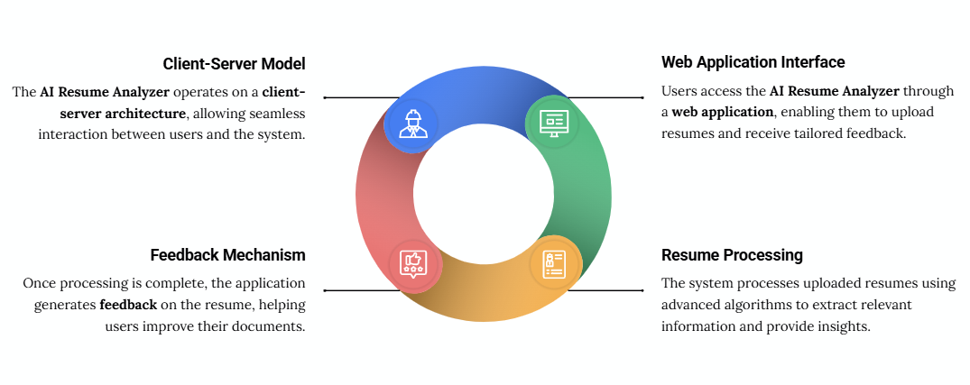
System Architecture

Slide 7
Results and Outcomes
The outcome is a userfriendly tool that provides valuable insights and recommendations for job applicants and powerful analytics for administrators.
1. User Interface : The sidebar on the left provides navigation options: "User," "Feedback," "About," and "Admin," along with a "Built with" attribution.
2. Resume Analysis : It displays a "Your Basic info" subsection, listing extracted details such as Name, Email, Contact, Degree, and the number of pages in the resume.
3. Skill Recommendation : The "Skills Recommendation" section is a key feature. It first shows "Your Current Skills" as interactive tags, which are extracted directly from the resume. Below this, based on the analysis of the current skills, the system predicts the user's likely job field.

Slide 8
Results and Outcomes
4. Course Recommendations : The "Courses & Certificates Recommendations" section provides actionable steps for skill development.
5. Tips & Score : This section offers constructive feedback on the resume's structure and content. It provides "Resume Tips & Ideas" by checking for the presence of crucial sections like Objective/Summary, Education, Experience, Internships, Skills, Hobbies, Interests, Achievements, Certifications, and Projects.
6. Video Recommendation : The tool includes "Bonus Video for Resume Writing Tips" and "Bonus Video for Interview Tips" sections.

Slide 9
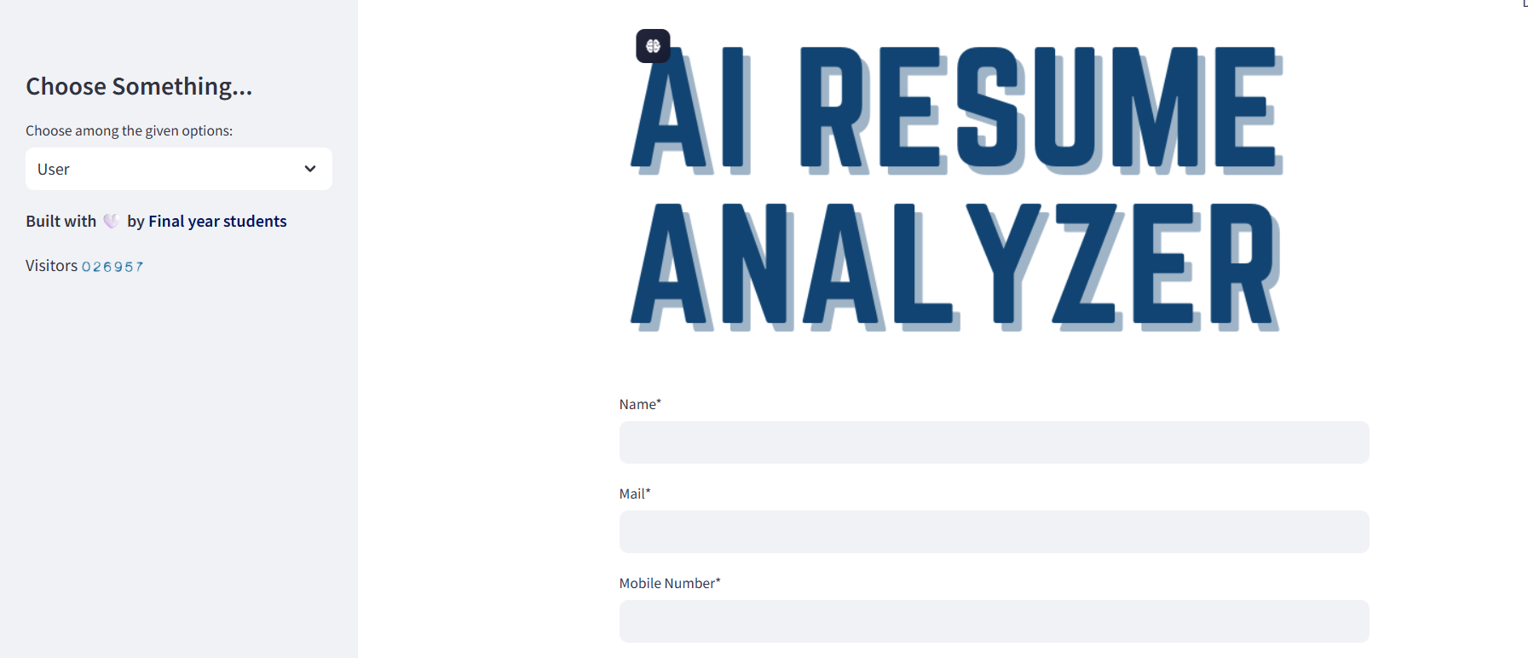
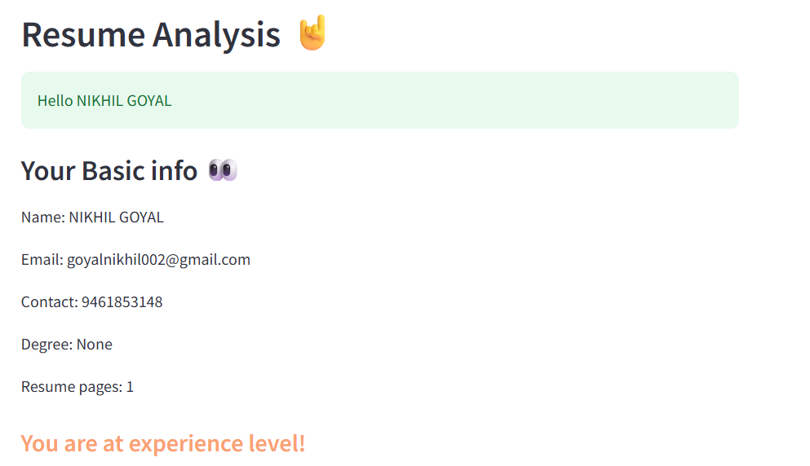
Results and Outcomes

Slide 10
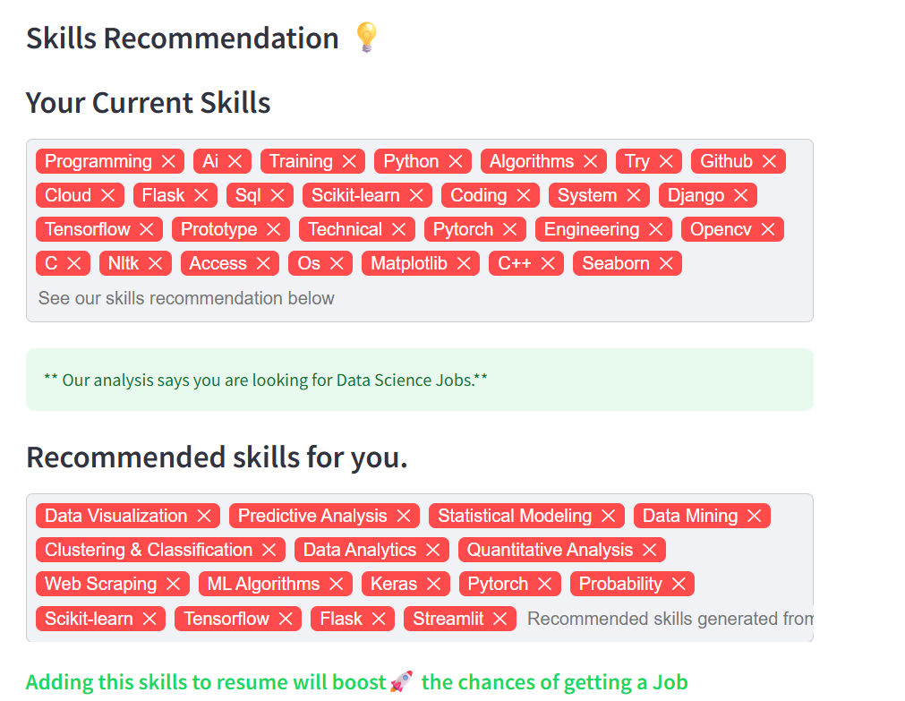
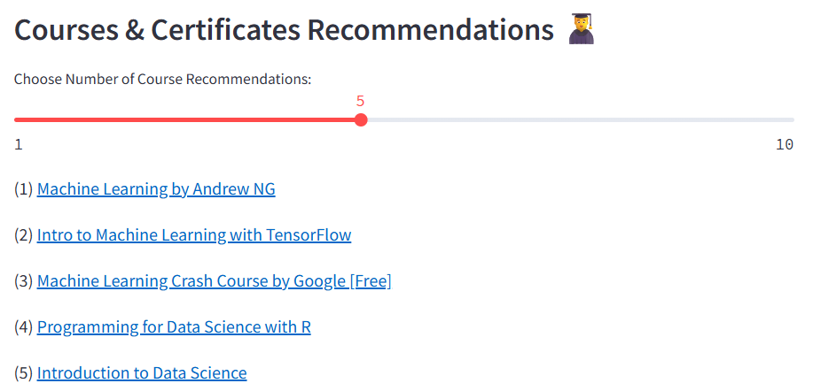
Results and Outcomes

Slide 11
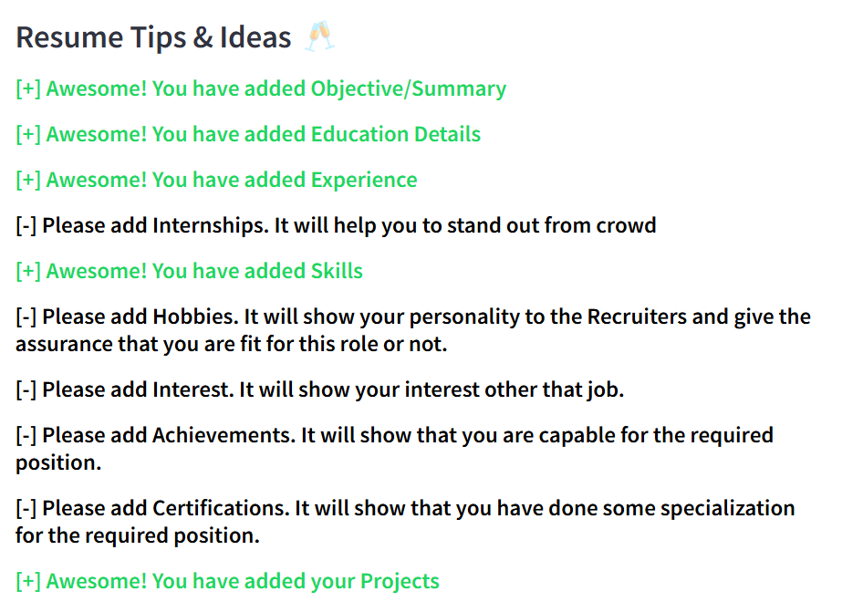

Results and Outcomes

Slide 12

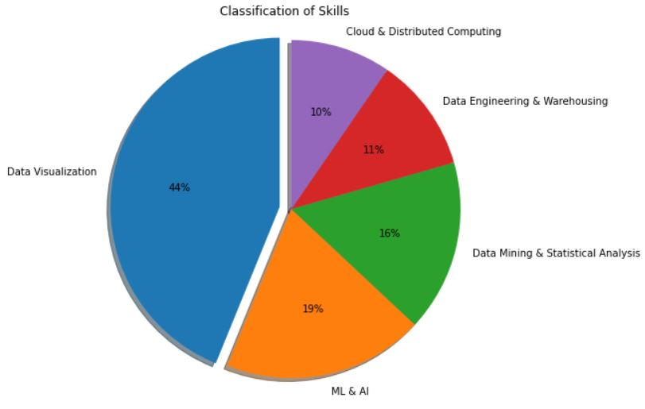
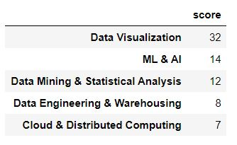
Skill-wise Classification

Slide 13
Future Enhancements
1. Expand Job Role Fields and Recommendations: Currently, recommendations are limited to Data Science, Web, Android, iOS, and UI/UX Development. Future work should focus on adding more fields for other roles (e.g., Cybersecurity, Cloud Engineering, DevOps, Marketing, Finance, Healthcare) and developing their respective keyword lists and recommendation sets.
2. Integration with Job Portals/ATS: Exploring the possibility of integrating with popular job portals or Applicant Tracking Systems (ATS) could allow for direct application submission or automated resume analysis within existing recruitment workflows.
3. Resume Template Suggestions and Generation: Based on the resume score and identified missing sections, the tool could suggest improvements to resume structure or even generate basic resume templates tailored to the user's predicted field.

Slide 14


Slide 15

DEMO

